Slide 1
Lecture 0
Informal Chat

Slide 2
Welcome to the course IT 209!
Why study computer architecture / organization?

Slide 3
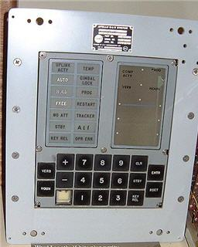
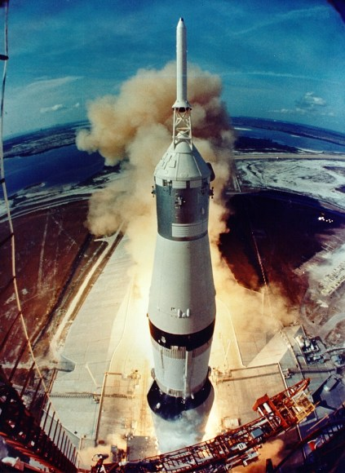
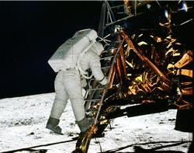
A little perspective on the 50th Anniversary of Moon landing…
Apollo 11’s Guidance Computer Specification: Designed at MIT and built by Raytheon; A rudimentary real time operating system ;

Slide 4
Apollo Guidance Computer, Block II (1965)
Memory (ROM): 36,864 words @ 16 bits (73,728 bytes) Memory (RAM): 2,048 words @ 16 bits (4,096 bytes) Clock Speed: 1 MHz Transistors: 16,800
Volume: 0.97 ft3 Weight: 70 lbs Power Consumption: 55 Watts

Slide 5
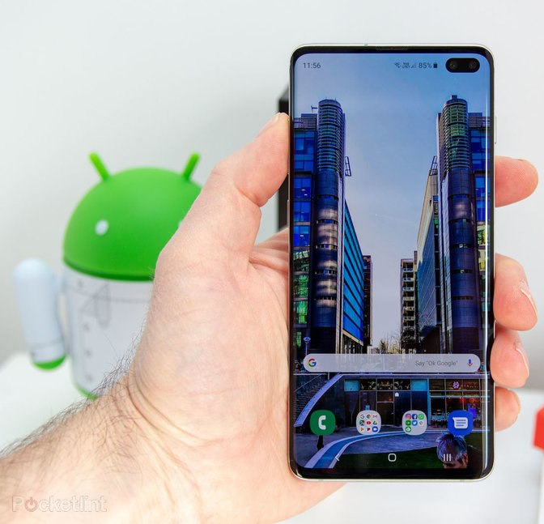
And now…

Slide 6
 | Galaxy S10e | Galaxy S10 | Galaxy S10+
SoC | (North America, China, Japan) Qualcomm Snapdragon 855 1x Kryo 485 (Cortex-A76) @ 2.84GHz 3x Kryo 485 (Cortex-A76) @ 2.42GHz 4x Kryo 485 (Cortex-A55) @ 1.80GHz Adreno 640 @ 585MHz
 | (Europe & Rest of World) Samsung Exynos 9820 2x Exynos M4 @ 2.73GHz 2x Cortex-A75 @ 2.31GHz 4x Cortex-A55 @ 1.95GHz Mali G76MP12 @ 702MHz
RAM | 6/8GB | 8GB | 8/12GB
Battery | 3100mAh (11.93Wh) typ. 3000mAh (11.55Wh) rated | 3400mAh (13.09Wh) typ. 3300mAh (12.71Wh) rated | 4100mAh (15.78Wh) typ. 4000mAh (15.4Wh) rated

Slide 7
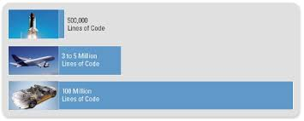
Relentless hunger for computing power…
Space shuttle
Boeing 787
Top segment Car
Premier Segment car now has 75 – 100 processor units
30% - 40% of the car price is due to electronics and related
software

Slide 8
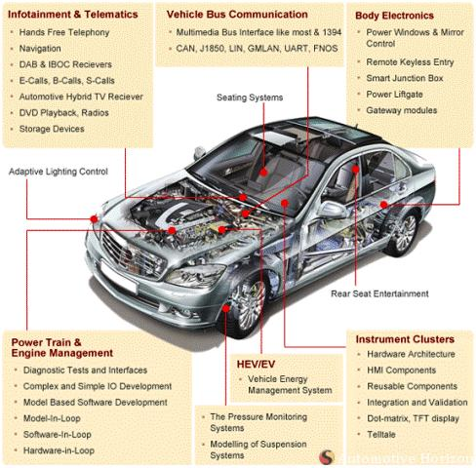

Slide 9
High Computing performance at lower cost…
It has made areas which were of theoretical interest couple of decades ago a reality
Prime examples: Artificial Intelligence, Machine Learning, Neural Network…

Slide 10
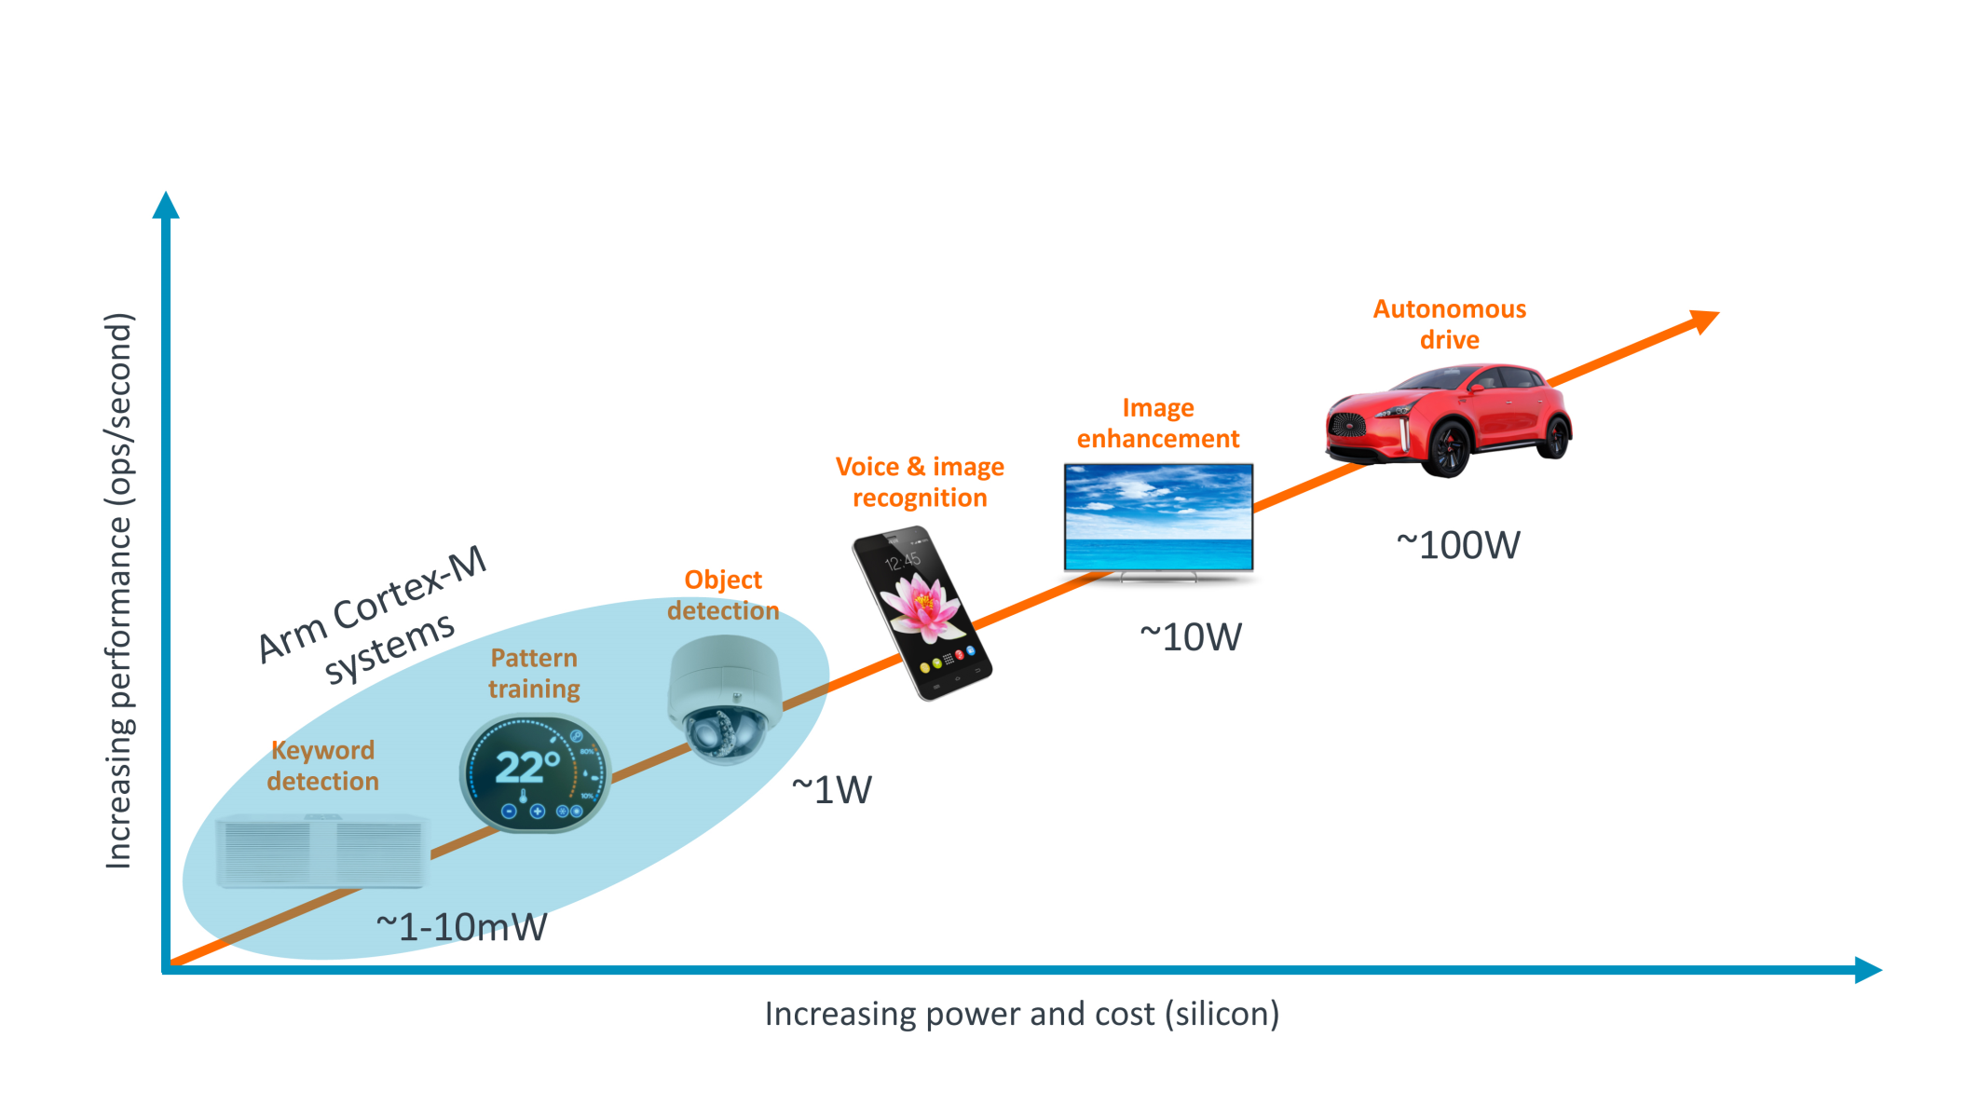
Edge devices and their power budgets
From Vikas Chandra, ARM

Slide 11
Historical view
Introduction of a new category
High Performance Computing (HPC)
Desktop/Laptop/Server Intel
Smartphones (MID)
Embedded System ARM
By 2015, MID market would be $29.9B

Slide 12
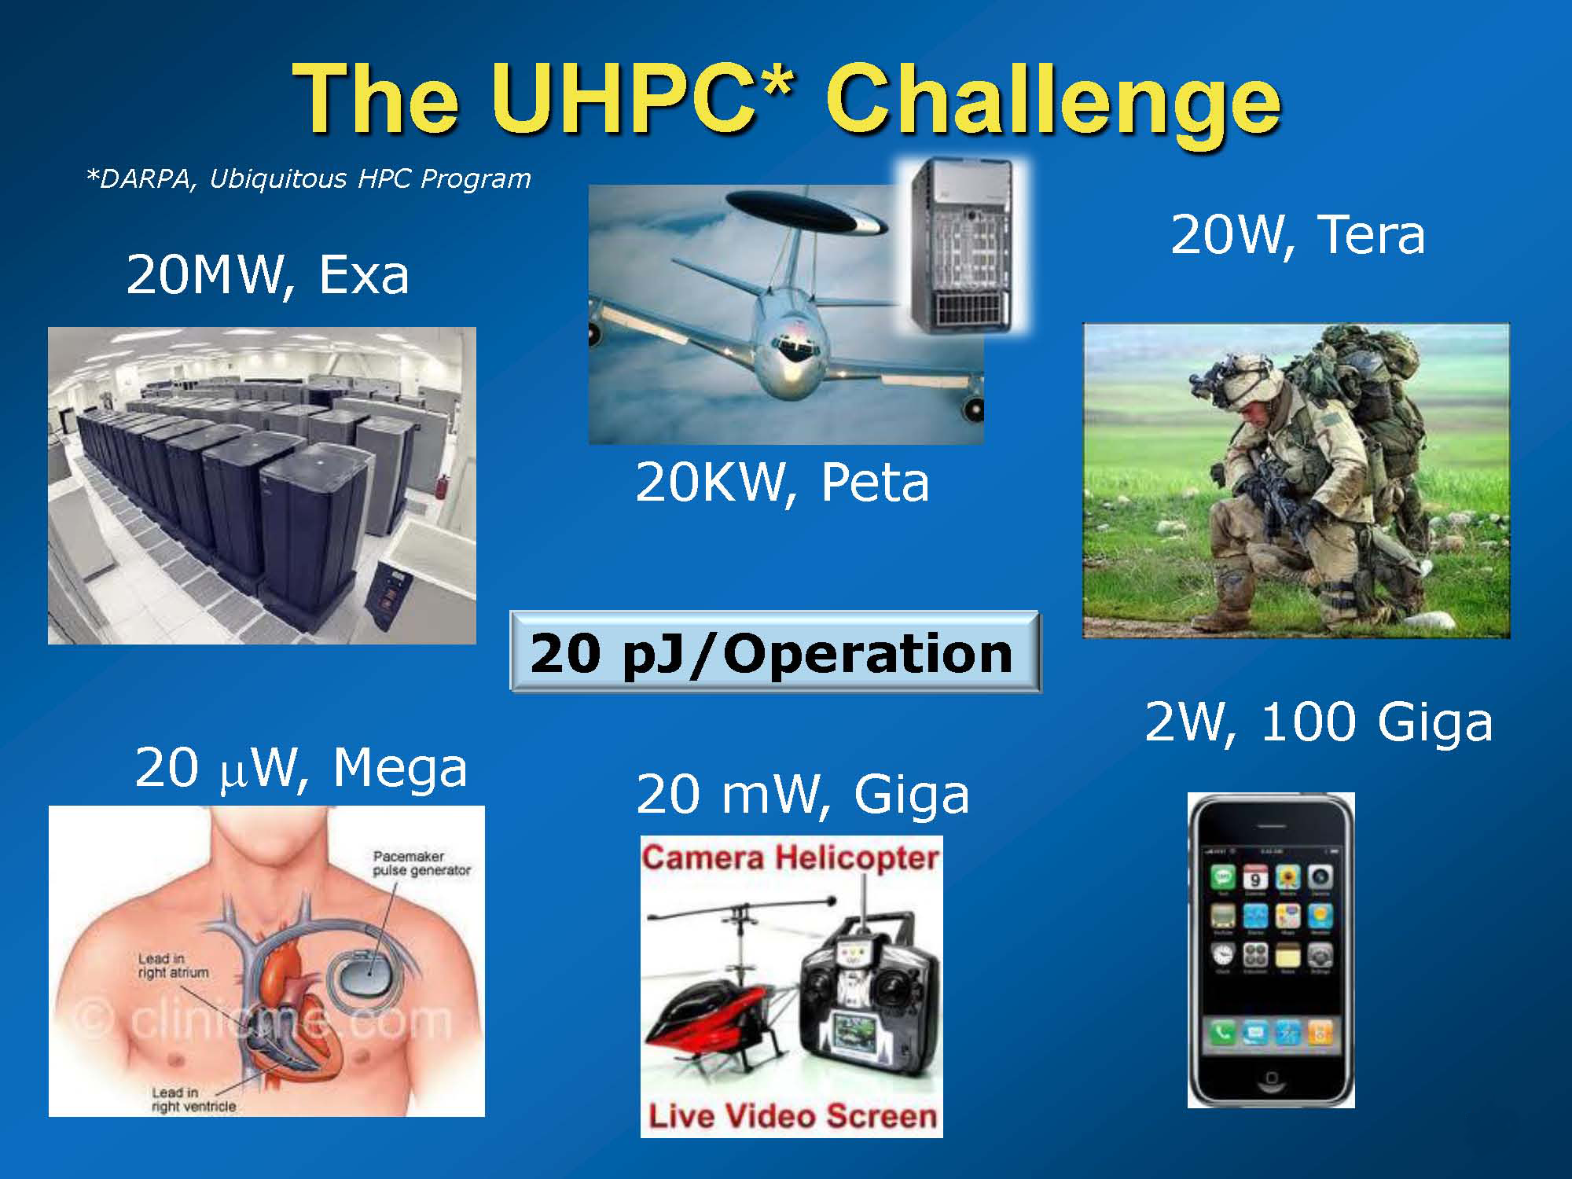

Slide 13
Software
Operating System, System software, Compiler
Computer Science
Instruction Set Architecture (ISA)
Register, Data path, I/O Control
Gate Level
Electronics / VLSI
Transistor Level
Device Physics Level

Slide 14
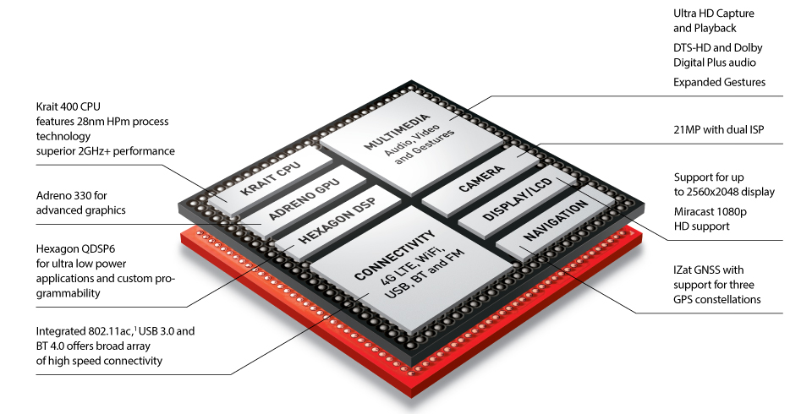

Slide 15


Slide 16
